Slide 1
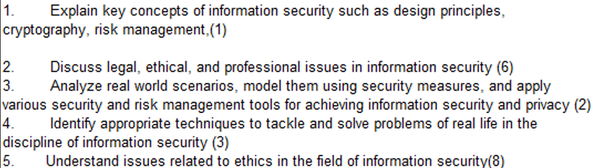
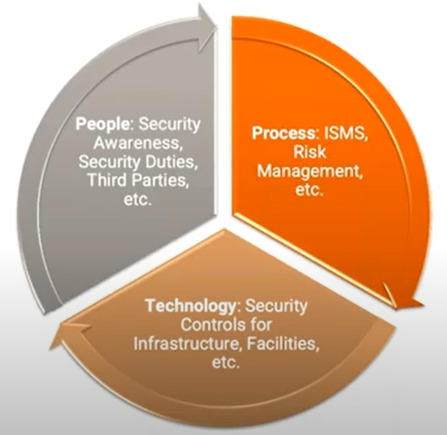
CS 3002 Information Security
Fall 2022
Week # 10 – Lecture # 25, 26, 27
28th, 29th, ??^{nd} Rabi ul Awwal, 1444
25th, 26th, 27th October 2022
Dr. Nadeem Kafi Khan

Slide 2
Lecture # 25 - LAB
SQL Injection Lab (task # 1)
Submission on GCR

Slide 3
Lecture # 26
Discretionary Access Control
Access Matric
Access Control Lists
Capability List
Virus Propagation Mechanism
Components of a Virus
Four phases of the life of a virus

Slide 4
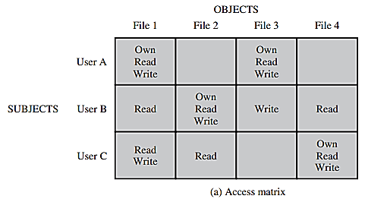
A discretionary access control scheme is one in which an entity may be granted access rights that permit the entity, by its own will, to enable another entity to access some resource.
A general approach to DAC, as exercised by an operating system or a database management system, is that of an access matrix.
Figure shows a simple example of an access matrix. Thus, user A owns files 1 and 3 and has read and write access rights to those files. User B has read access rights to file 1, and so on.

Slide 5
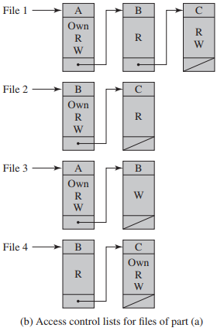
The matrix may be decomposed by columns, yielding access control lists (ACLs) (see Figure).
For each object, an ACL lists users and their permitted access rights. The ACL may contain a default, or public, entry. This allows users that are not explicitly listed as having special rights to have a default set of rights.
The default set of rights should always follow the rule of least privilege or read-only access, whichever is applicable.
Elements of the list may include individual users as well as groups of users. When it is desired to determine which subjects have which access rights to a particular resource, ACLs are convenient, because each ACL provides the information for a given resource.
However, this data structure is not convenient for determining the access rights available to a specific user.

Slide 6
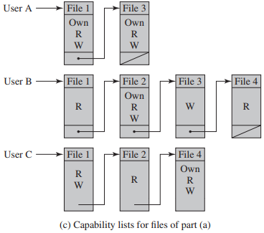
Decomposition by rows yields capability tickets (see Figure).
A capability ticket specifies authorized objects and operations for a particular user. Each user has a number of tickets and may be authorized to loan or give them to others.
Because tickets may be dispersed around the system, they present a greater security problem than access control lists.
The integrity of the ticket must be protected, and guaranteed (usually by the operating system).
In particular, the ticket must be unforgeable. One way to accomplish this is to have the operating system hold all tickets on behalf of users. These tickets would have to be held in a region of memory inaccessible to users.
The convenient and inconvenient aspects of capability tickets are the opposite of those for ACLs. It is easy to determine the set of access rights that a given user has, but more difficult to determine the list of users with specific access rights for a specific resource.

Slide 7
This category of malware propagation concerns parasitic software fragments that attach themselves to some existing executable content.
The fragment may be machine code that infects some existing application, utility, or system program, or even the code used to boot a computer system.
Recent addition is some form of scripting code, typically used to support active content within data files such as Microsoft Word documents, Excel spreadsheets, or Adobe PDF documents.
Computer virus infections formed the majority of malware seen in the early personal computer era.
The term “computer virus” is still often used to refer to malware in general, rather than just computer viruses specifically.

Slide 8
Most viruses carry out their work that is specific to a particular operating system and/or to a particular hardware platform.
Thus, they are designed to take advantage of the details and weaknesses of particular systems. Macro viruses however target specific document types, which are often supported on a variety of systems.
A virus can infect some or all of the other files on that system with executable content when it executes. Depending on the access permissions it has.
Thus Viral infection can be completely prevented by blocking the virus from gaining entry in the first place.
Unfortunately, prevention is extraordinarily difficult because a virus can be part of any program outside a system.
Thus, unless one is content to take an absolutely bare piece of iron and write all one’s own system and application programs, one is vulnerable.
Many forms of infection can also be blocked by denying normal users the right to modify programs on the system.

Slide 9
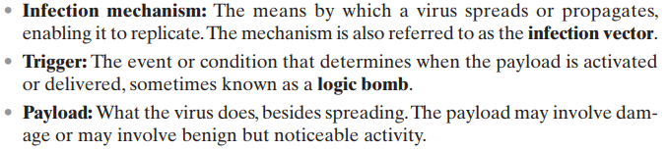
A computer virus (and many types of current malware) has three components:

Slide 10
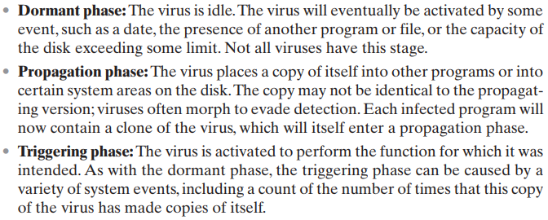

A typical virus goes through the following four phases during its lifetime:

Slide 11
Lecture # 27
Quiz # 2

